Slide 1
IRNSS Receiver
Project Presentation

Slide 2
Group No. B17
Varun Bandaru 150070047
Theja Voora 150070052
P N Aditya 150070044
Faculty Mentor : Prof. Shalabh Gupta
TA/RA : Romil Jain, Shubham Dhage
Objectives:
To design the RF front-end of IRNSS receiver on a single PCB.
To design an antenna for the L5 band (1176.45 MHz).

Slide 3
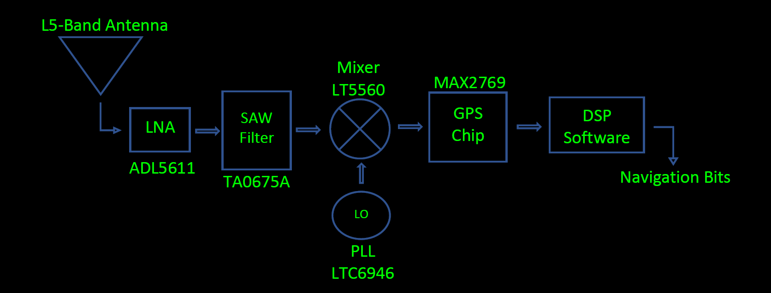
Block Diagram

Slide 4
Microstrip Antenna (MSA)
We designed a RHCP antenna to receive the L5 band (1176.45 MHz) signals.
A circularly polarized MSA can be realized by exciting two orthogonal modes of equal magnitudes, which are in phase quadrature.
A 3 dB two branch line coupler with Z₁=35 Ω and Z₂=50 Ω is used to provide equal amplitude with a 90º phase difference at the centre of the two adjacent edges of the square MSA.
The input impedance at the two adjacent edges (100 Ω) is transformed to 50 Ω by using quarter wave transformers of Z₀ = 70.7 Ω.

Slide 5
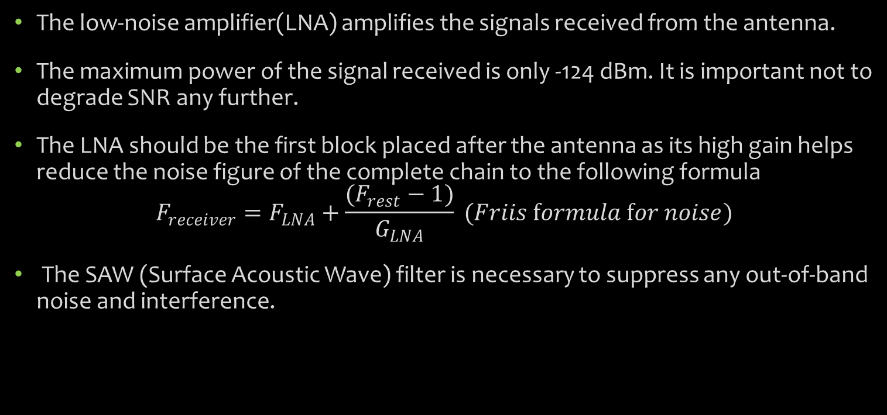
LNA and SAW Filter
The low-noise amplifier(LNA) amplifies the signals received from the antenna.
The maximum power of the signal received is only -124 dBm. It is important not to degrade SNR any further.
The LNA should be the first block placed after the antenna as its high gain helps reduce the noise figure of the complete chain to the following formula
$$F_{receiver}=F_{LNA}+\frac{(F_{rest}−1)}{G_{LNA}} (Friis formula for noise)$$
The SAW (Surface Acoustic Wave) filter is necessary to suppress any out-of-band noise and interference.

Slide 6
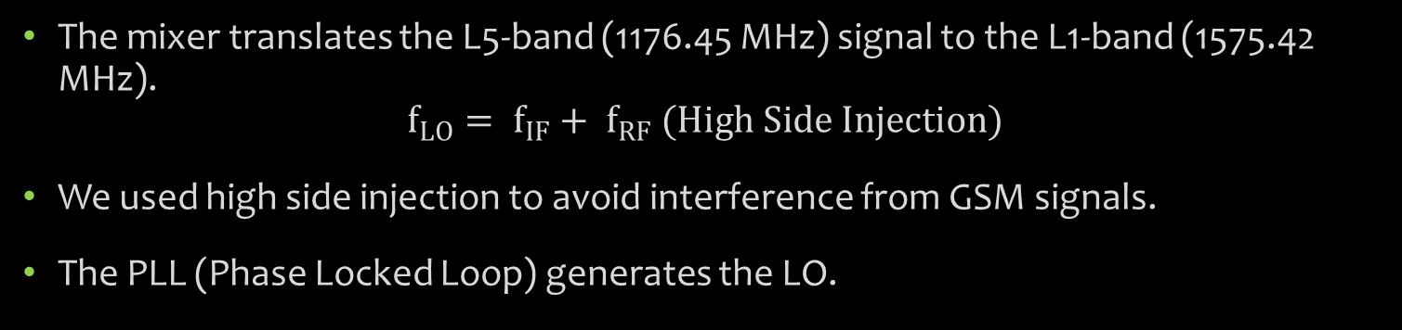
Mixer and PLL
The mixer translates the L5-band (1176.45 MHz) signal to the L1-band (1575.42 MHz).
$$f_{LO}= f_{IF}+ f_{RF} (High Side Injection)$$
We used high side injection to avoid interference from GSM signals.
The PLL (Phase Locked Loop) generates the LO.
GPS Chip
It is highly efficient in terms of the gain it provides(maximum of 96dB) as well as the space it takes.
It consists of a quadrature mixer which down-converts the received L1 band signal to baseband. I and Q components which are then sampled through an internal ADC.

Slide 7
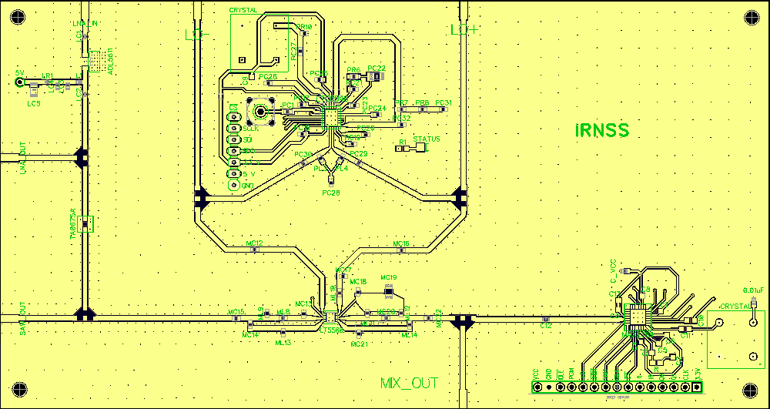
Our PCB layout

Slide 8
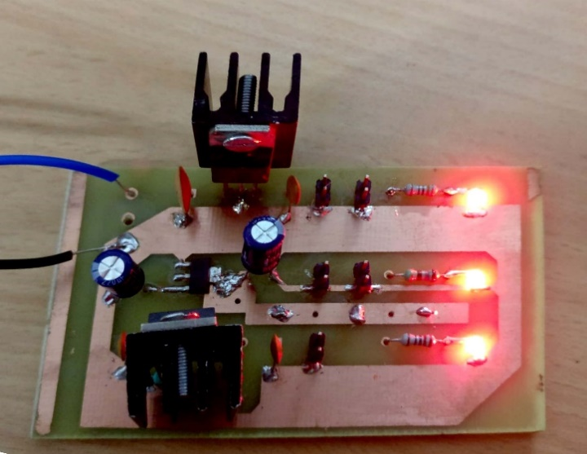
Power Board
We needed 5V, 3.3V and 3V supplies to power the board.
We used LM7805, LM1117 and LM317 voltage regulator ICs respectively to obtain the specified voltages from a 12V power supply.
LEDs are also placed for identification of any power supply related problems.

Slide 9
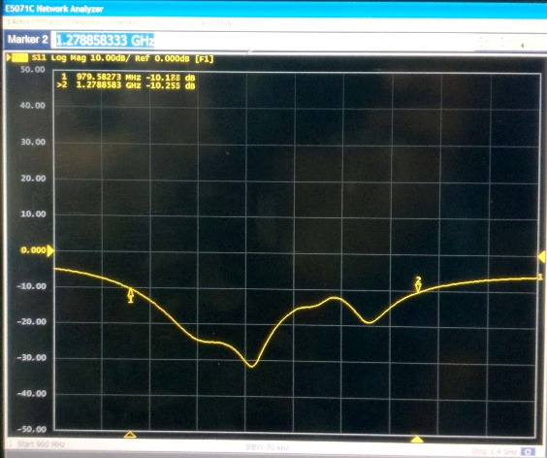
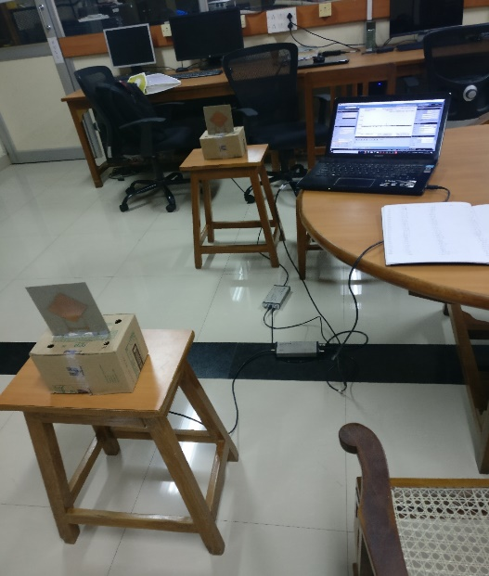
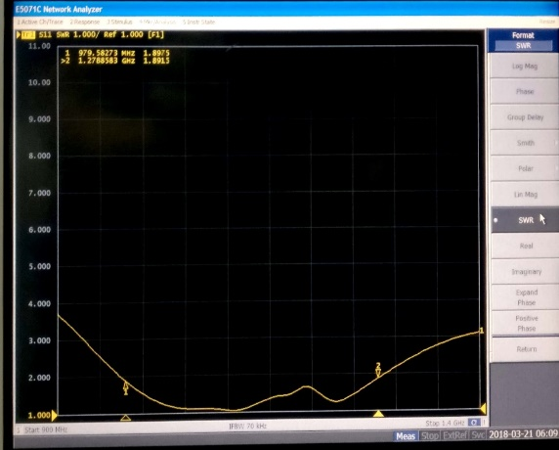
Antenna test Results
S₁₁ parameter
VSWR
Antenna Testing Setup

Slide 10
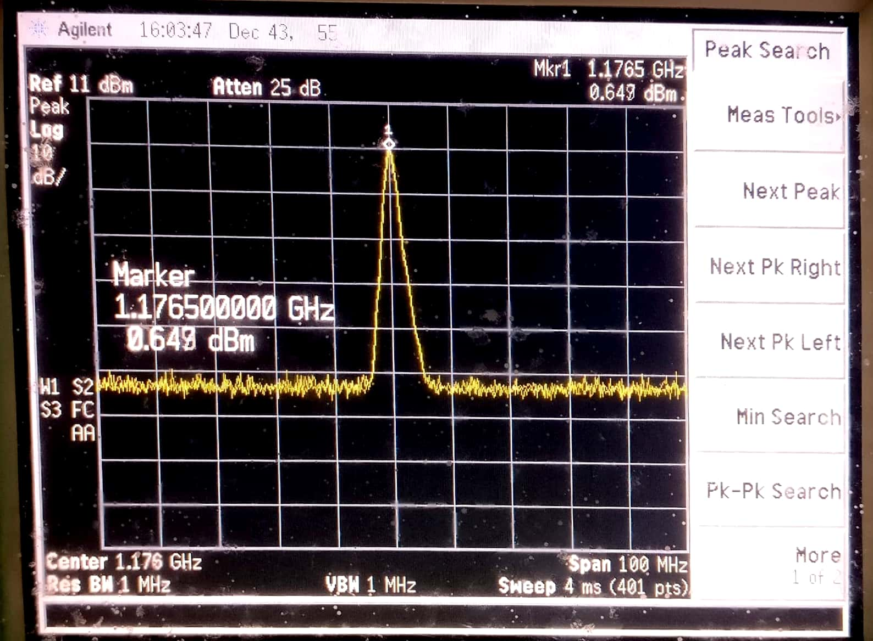
LNA and SAW filter test results
LNA Gain Testing
20.5 dB gain was observed

Slide 11
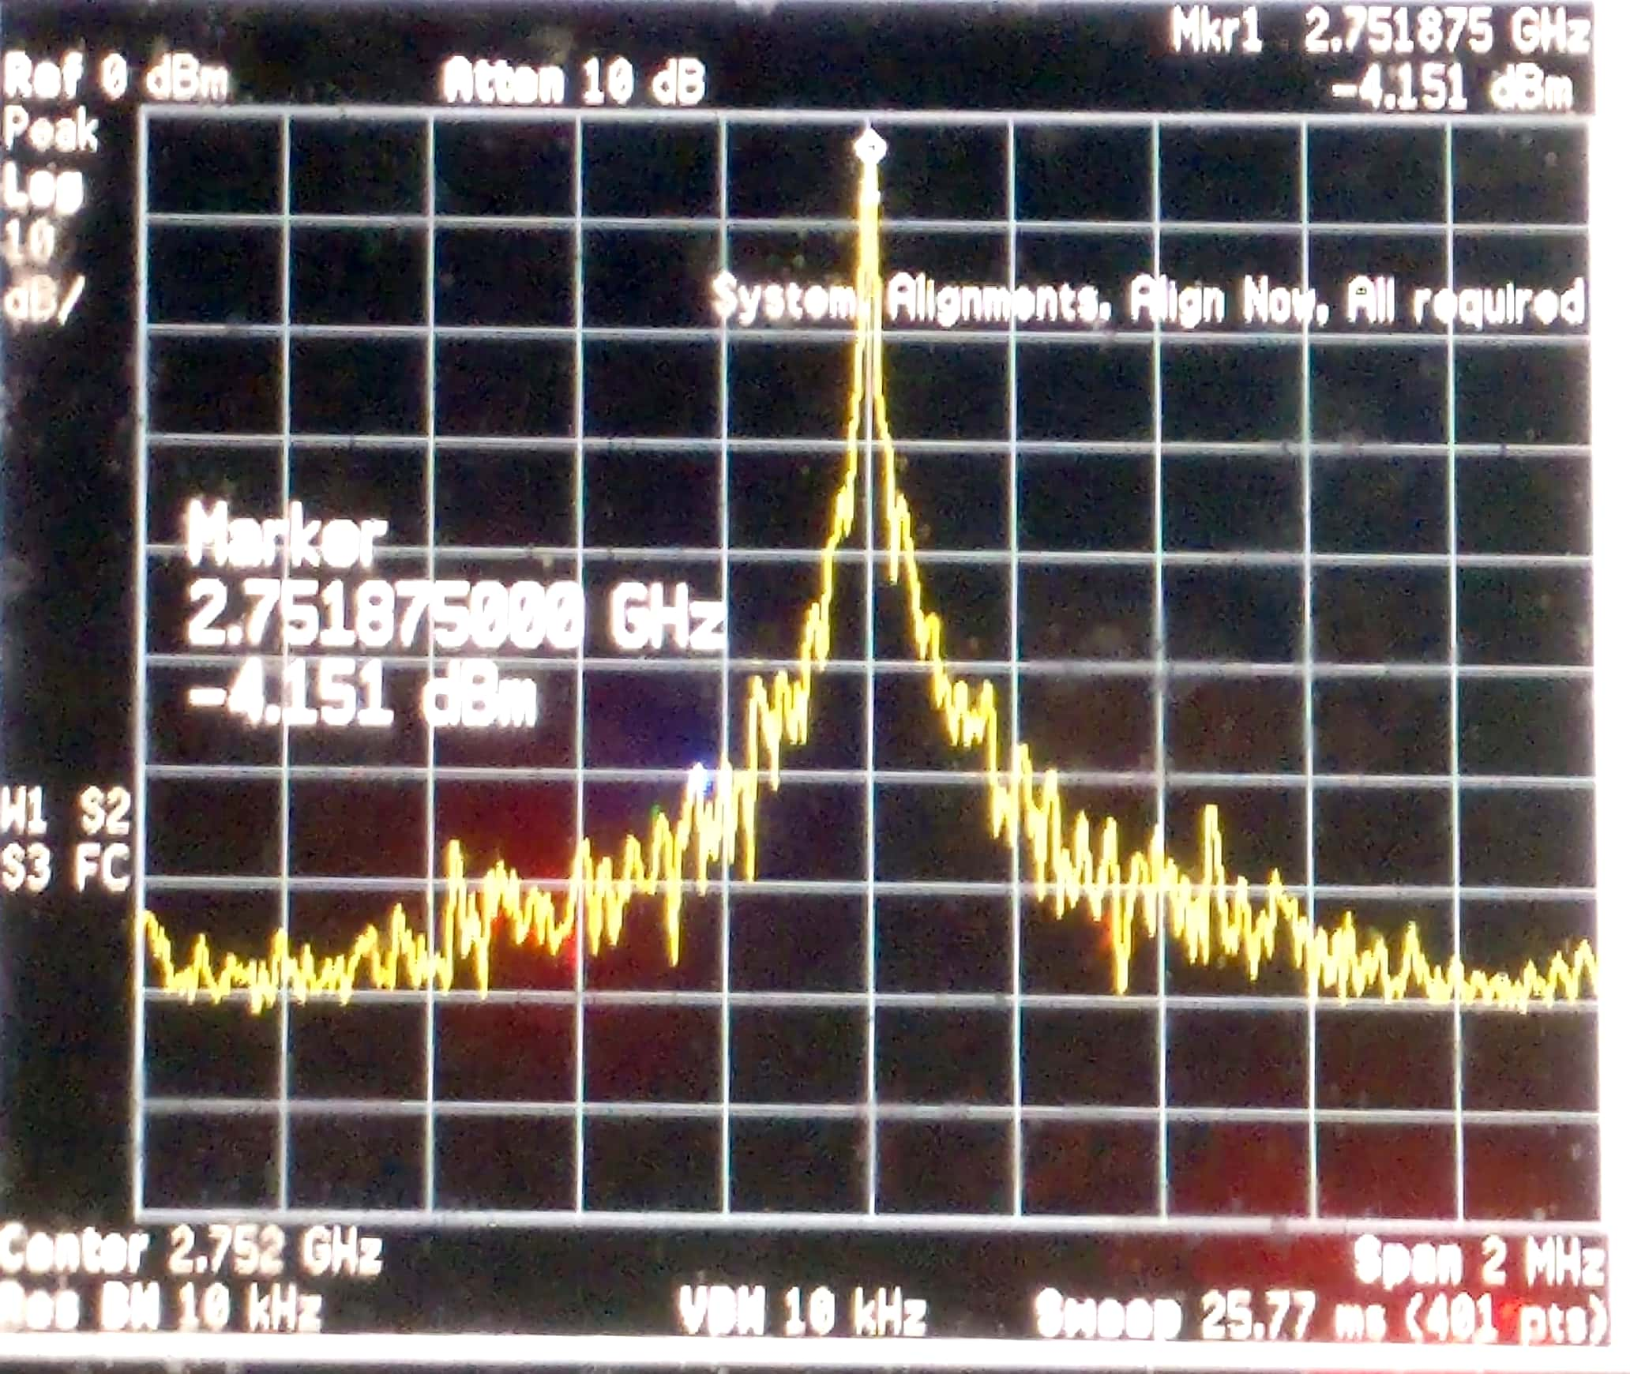
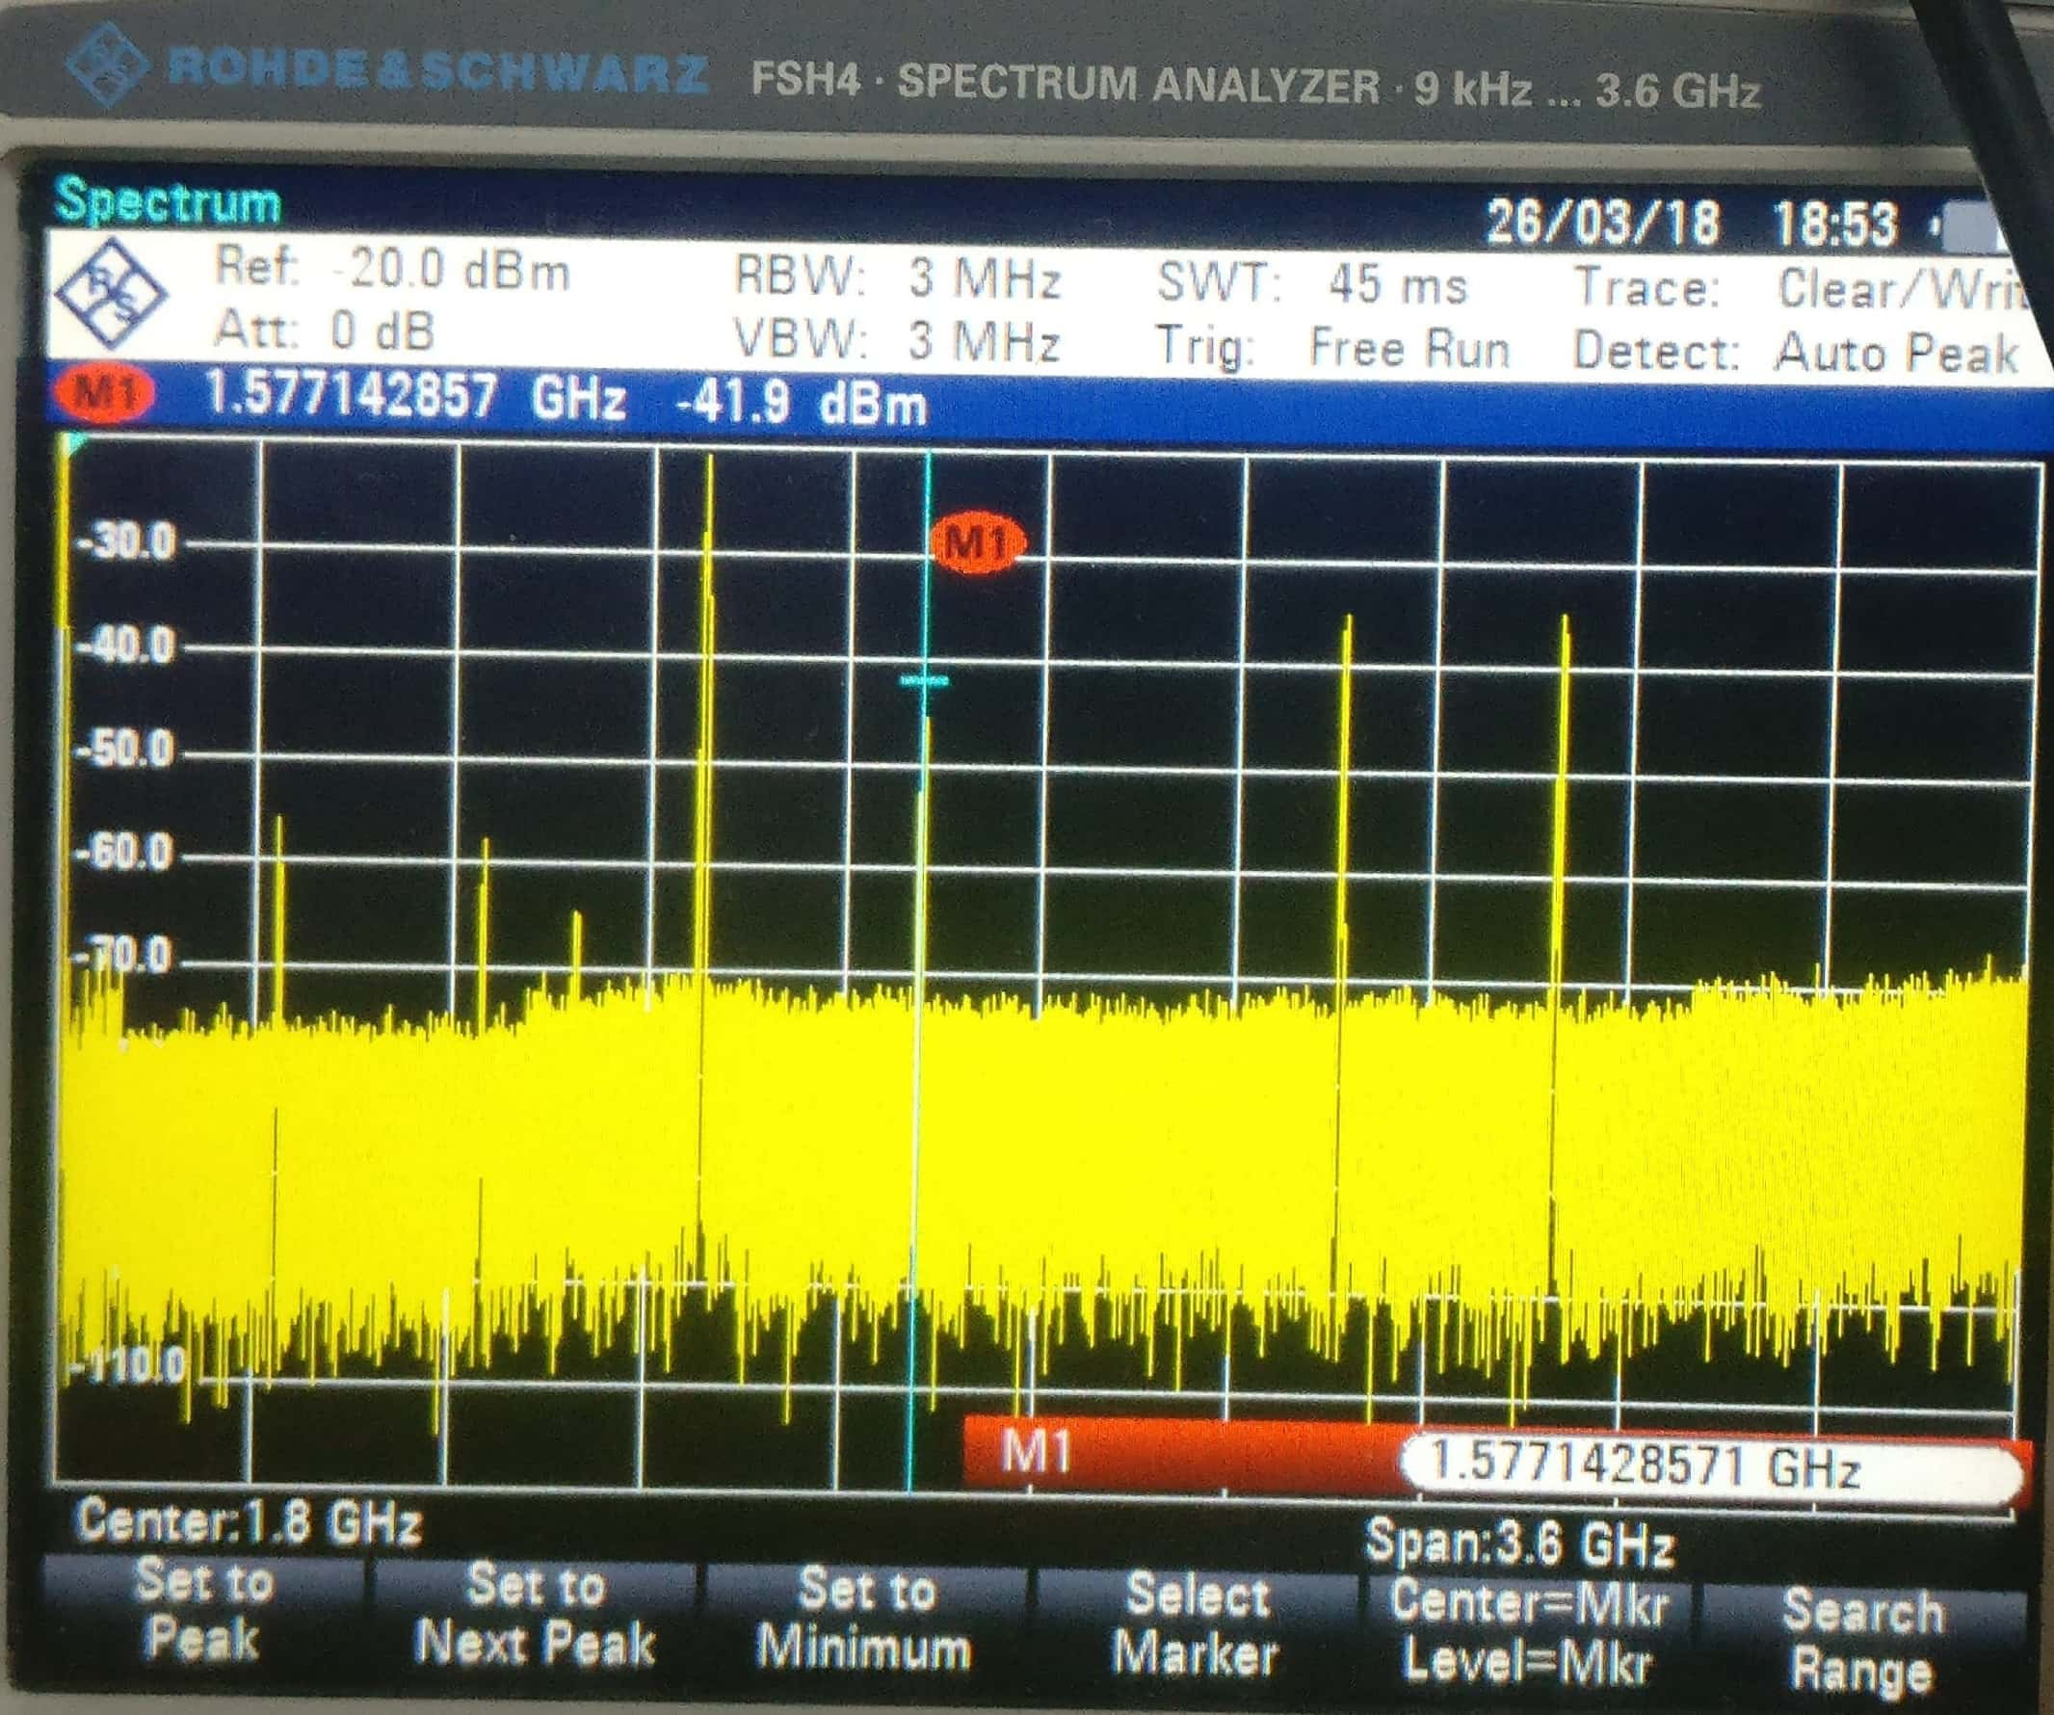
PLL and mixer test results
PLL Testing
Peak at 2751.87 MHz was observed
Mixer Testing

Slide 12
Thank You

